Slide 1
Heapsort and Quicksort
Chaklam Silpasuwanchai

Slide 2
Readings
Chapter 6-7, Heapsort, Quicksort, Cormen et al. (2009). Introduction to Algorithms, Third Edition (3rd ed.). The MIT Press

Slide 3
Outline
Heapsort
Priority queues
Quicksort

Slide 4
Heapsort

Slide 5
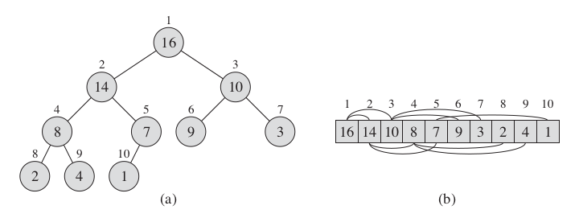
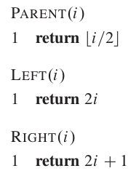
Heaps
Binary heap data structure is an array object that can be view as complete binary tree
Filled on all levels except the lowest, which is filled from left up to a point
A.length gives the number of elements in the array while A.heap-size represents how many elements in the heap are stored within array A
We will see why heap does not necessarily occupy the whole array
Given index i of a node, we can easily compute its parent, left and right child

Slide 6


Max and Min Heap
In a max-heap, every node i other than the root should satisfy
Otherwise for min-heap
For heapsort, max-heap is used
For priority queues, min-heap is used

Slide 7
Heap as tree
Height of the heap is the the number of edges on the longest downward path from the root to leaf, where leaf is node without any children. A leaf node has height of 0.
Depth of a node is number of edges from the node to the tree’s root node. A root node has depth of 0.
Since a heap of n elements is based on a complete binary tree, its height is 𝚯(lg n); the # of nodes in a complete binary tree (so does heap) is 2^{h+1} -1. Minimum node of of a heap is 2^{h}
We shall see why heap is such a good data structure as basic operations in heap takes time at most proportional to the heap’s height
Basic operations of heap:
MAX-HEAPIFY - runs in O(lg n) that maintains the max-heap property
BUILD-MAX-HEAP - runs in linear time, produce a max-heap from an unordered array
HEAPSORT - runs in O(n lg n), sorts an array in place
MAX-HEAP-INSERT, HEAP-EXTRACT-MAX, HEAP-INCREASE-KEY, and HEAP-MAXIMUM - runs in O(lg n) allowing heap to implement a priority queue

Slide 8
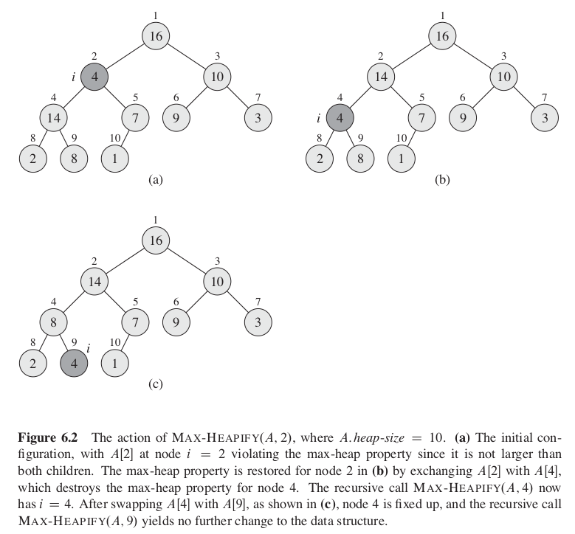
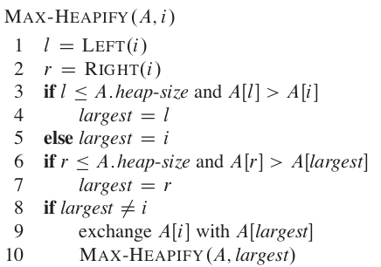

MAX-HEAPIFY
The comparison between A[i], A[LEFT(i)] and A[RIGHT(i)] takes Θ(1) time
The children’s subtress each have size at most 2n/3 - occurs when the bottom level of the tree is exactly half full
Thus we can explain the running of MAX-HEAPIFY as
Use master theorem case 2, T(n) = O(lg n) or O(h)

Slide 9

Why 2/3n
Geometric series:
Lucky case for subproblem size is when tree is balanced, that is, n/2
However, it can happen when left > right, or right > left subtrees. In that case, the upper bound for the subproblem size will be 2n/3
Let N = number of nodes in a tree, L = number of nodes in left subtree where its height is more than R by one, and R for right subtree
N = 1 + L + R (1 is for root)
L = 1 + 2 + 4 + 8 + …. + 2^{h+1} = 2^{h+2} - 1
R = 1 + 2 + 4 + 8 + …. + 2^{h} = 2^{h+1} - 1
N = 1 + 2^{h+2} - 1 + 2^{h+1} - 1
N = 1 + 2 * 2^{h+1} - 1 + 2^{h+1} - 1
N = 3 * 2^{h+1} - 1
(N + 1) / 3 = 2^{h+1}
Plug this value to L, we get
L = 2^{h+2} - 1 = 2 * (N+1) / 3 - 1 = (2N-1)/3 < (2N/3)
Note that it can also be R that is bigger than L

Slide 10
Exercises
CLRS 6.2-1
Illustrate the operation of MAX-HEAPIFY(A, 3) on the array
A = <27, 17, 3, 16, 13, 10, 1, 5, 7, 12, 4, 8, 9, 0>

Slide 11
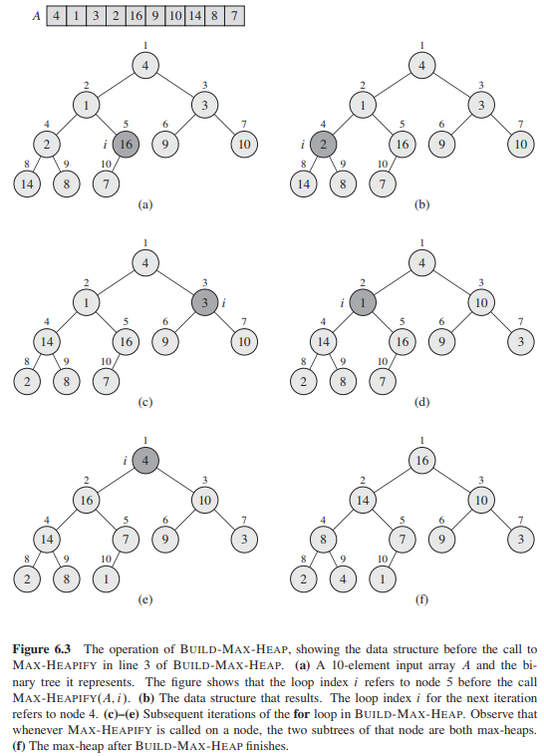
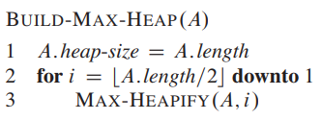




BUILD-MAX-HEAP
No children can be indexed by node A[n/2 + 1]...n]
Each call to MAX-HEAPIFY costs O(lg n) time
BUILD-MAX-HEAP makes n/2 or O(n) such calls
Thus the running time is O(n lg n)
We can also derive an even tighter bound based on some information
Observe that the time of MAX-HEAPIFY depends on height of the node
A n-element heap has height ⌊lg n⌋ and at most ⌈n / 2^{h+1}⌉ nodes of height h
Each call to MAX-HEAPIFY costs O(lg n) time
Thus the running time is
Note:
→

Slide 12
Exercises
CLRS 6.3-1
Illustrate the operation of BUILD-MAX-HEAP on the array A = <5, 3, 17, 10, 84, 19, 6, 22, 9>

Slide 13
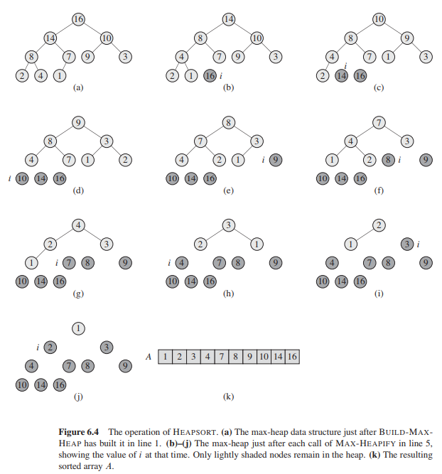
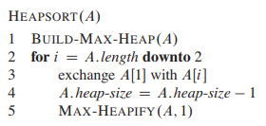
HEAPSORT
The heapsort algorithm starts with BUILD-MAX-HEAP.
The maximum element will be at A[1]
We swap last element with A[1] so the maximum is put into the correct place
Heapsort takes O(n lg n), since BUILD-MAX-HEAP takes time O(n) and each of the n - 1 calls to MAX-HEAPIFY takes time O(lg n)
Note:

Slide 14
Exercises
CLRS 6.4-1
Illustrate the operation of HEAPSORT on the array A = <5, 13, 2, 25, 7>

Slide 15
Heap sort - Unstable sort
Consider array 21 20a 20b 12 11 8 7
Here 20a = 20b just to differentiate the order we represent them as 20a and 20b
While heapsort first 21 is removed and placed in the last index then 20a is removed and placed in last but one index and 20b in the last but two index so after heap sort the array looks like
7 8 11 12 20b 20a 21.
It does not preserve the order of elements and hence can't be stable

Slide 16
Heap sort - Unstable sort application
If you are using a web, and you have many columns where you can click to sort stuff,
If you want to sort stuff based on A, B, C, then you can click on C, B, A accordingly
This trick only applies if you are using stable sort
Heapsort and quicksort are not stable sort. Others are.

Slide 17
Heap sort - Pros and Cons
Pros | Cons
Consistent in best, average, worst cases | Unstable sort The order can change Exchange a lot

Slide 18
Quicksort

Slide 19
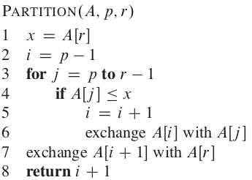
Demo

Slide 20
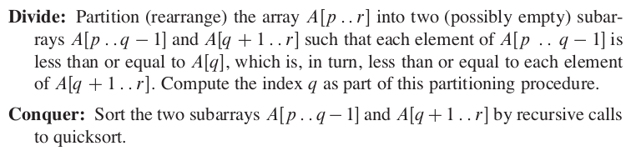
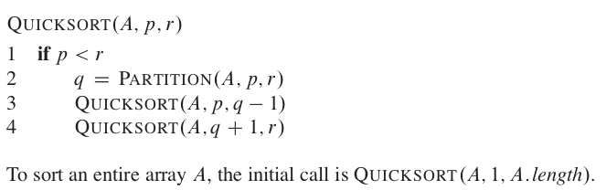
Quicksort

Slide 21
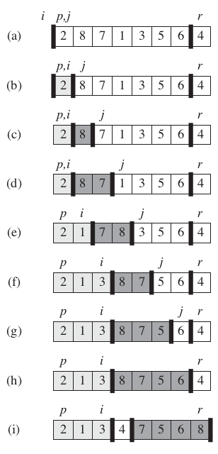
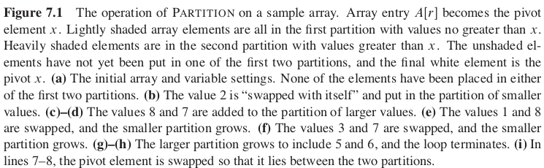

Quicksort
Selects A[r] as a pivot element for partitioning
We need to make elements in A[p….i] less than or equal to x, A[i+1...j-1] greater than x, and A[r] = x = pivot
A[j...r-1] is simply place where the partitioning does not happen yet
Takes Θ(n) time

Slide 22


Quicksort
Performance depends on how well the pivot is used for partitioning. If the partition is balanced, it will yield optimal performance. By case 2 of master theorem, this is T(n) = Θ(n lg n):
Otherwise, it will run as slowly as insertion sort, in the case when pivot is the smallest or biggest element. The recurrence running time is Θ(n²)

Slide 23
Quick sort - Pros and Cons
Pros | Cons
Easy to avoid worst case by using median-of-three approach Space-efficiency of log n to allocate temporary space for keeping pivots | If you are unlucky, and get a dataset of (1,1,1,1), then you are unlucky

Slide 24
Exercise
Illustrate quicksort on array A = <15, 13, 9, 5, 12, 8, 7, 11>
i | p j |  |  |  |  |  |  | r
 | 15 | 13 | 9 | 5 | 12 | 8 | 7 | 11
 | p i |  | j |  |  |  |  | r
 | 9 | 13 | 15 | 5 | 12 | 8 | 7 | 11
 | p | i |  | j |  |  |  | r
 | 9 | 5 | 15 | 13 | 12 | 8 | 7 | 11
 | p |  | i |  |  | j |  | r
 | 9 | 5 | 8 | 13 | 12 | 15 | 7 | 11
 | p |  |  | i |  |  | j | r
 | 9 | 5 | 8 | 7 | 12 | 15 | 13 | 11
 | p |  |  | i |  |  | j | r
 | 9 | 5 | 8 | 7 | 11 | 15 | 13 | 12

Slide 25
Assignment
Implement heapsort and quicksort and compare their complexity

